Slide 1


Optimization of Machine Downtime
A system or equipment unexpectedly stops working due to unforeseen events
Disrupts the normal workflow and production processes
Affects the operational efficiency

Slide 2
Contents
Business Objective
Business Constraints
Project Architecture - Data Flow Diagram
Data Collection
Exploratory Data Analysis
Data Visualization
Notes:
Change

Slide 3
Business Problem
Business Problem :
Unplanned machine downtime , leading to loss of productivity
Business Objectives :
Minimize unplanned machine downtime
Business Constraints :
MInimize maintenance cost
Maximize equipment efficiency
Success Criteria :
Business Success Criteria -
Reduce the unplanned downtime by at least 10%
Economic Success Criteria -
Achieve a cost saving of at least $1M

Slide 4
Project Overview and Scope
Optimizing machine operations to minimize unplanned downtime by analyzing operational data and implementing predictive maintenance solutions .
The goal is to analyze the trends and patterns of all the factors, and develop insights to prevent the unexpected downtime, especially due to machine failures.
The data is collected and cleaned, statistical analysis is done using SQL and performed EDA using Python.

Slide 5
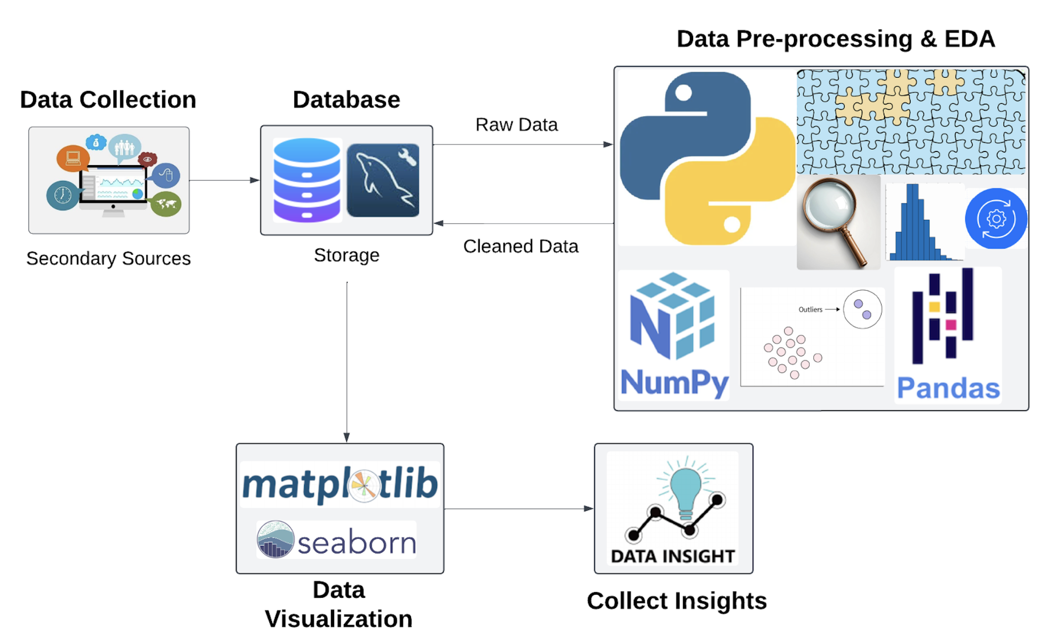
Project Architecture

Slide 6
Data Dictionary
2500 rows / records
16 columns
Categorical Columns : Date, Machine ID, Assembly Line Number, Downtime
Numerical Columns : Hydraulic Pressure, Coolant Pressure, Air System Pressure, Coolant Temperature, Hydraulic Oil Temperature, Spindle Bearing Temperature, Spindle Vibration, Tool Vibration, Spindle Speed, Voltage, Torque and Cutting

Slide 7
Data Dictionary
Date - the date when the data was recorded.
Machine ID - Unique identifier for each machine.
Assembly Line Number - Identifier for the assembly line the machine belongs to.
Hydraulic Pressure - Represents the pressure in the hydraulic system, measured in bars.
Coolant Pressure - Coolant pressure reading in bars.
Air System Pressure - Air system pressure in bars.
Coolant Temperature - Temperature of the coolant.
Hydraulic Oil Temperature - Temperature of the hydraulic oil given in °C.
Spindle Bearing Temperature - Temperature of the spindle bearings in °C.
Spindle Vibration - Spindle vibration in micrometers.
Tool Vibration - Vibration of the tool in micrometers.
Spindle Speed - Spindle speed in revolutions per minute (RPM).
Voltage - Voltage reading in volts.
Torque - Torque applied in Newton-meters (Nm).
Cutting - Cutting force in kilonewtons (kN).
Downtime - The target variable indicating the cause of machine downtime - whether machine failure or not.

Slide 8
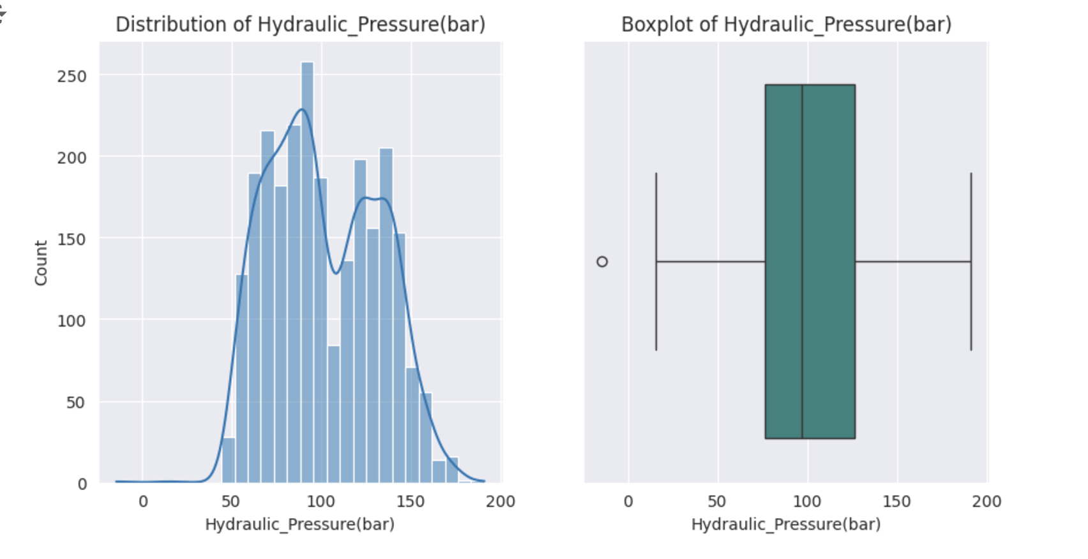
Exploratory Data Analysis [EDA]
Hydraulic Pressure
Mean : 101.41
Median : 96.76
Mode : 3 modes :
88.279134,
89.458747, 90.458747
Variance : 917.4417 bar
Standard Deviation : 30.29
Range : 205.327
Skewness : 0.197
Kurtosis : -0.920292
Notes:
EDA is used for seeing what the data can tell us before the modeling task.
Change

Slide 9
Exploratory Data Analysis [EDA]
Statistical Insights
Business Insights
Outlier: Minimum value is --14.33 ; pressure is typically positive.
Distribution:
Mean (101.41) > Median (96.76): Slightly right-skewed (Skewness = 0.197), almost symmetrical.
No transformation required; mean imputation suitable for missing values.
Clusters: Multiple modes (88.28, 89.46, 90.46) suggest small clusters.
Shape: Platykurtic distribution (Kurtosis = -0.920292); thinner tails.
Spread:
Range: Wide operational limits (205.327).
Variance (917.4417) and Standard Deviation (30.29) indicate some variability.
High Pressure Operations : Investigate reasons (e.g., specific products or larger quantities). If unavoidable, schedule frequent maintenance to minimize risks.
Wide Pressure Range : High variability may reduce machine lifespan and increase downtime risks.
Modes vs. Mean : Modes lower than the mean - optimum pressure usage
Safety Concerns : High-pressure conditions.
Anomalies : Negative pressure values and their causes.
Maintenance : Regular checks to reduce wear and tear, optimize costs, and improve efficiency.
Notes:
EDA is used for seeing what the data can tell us before the modeling task.
Change

Slide 10
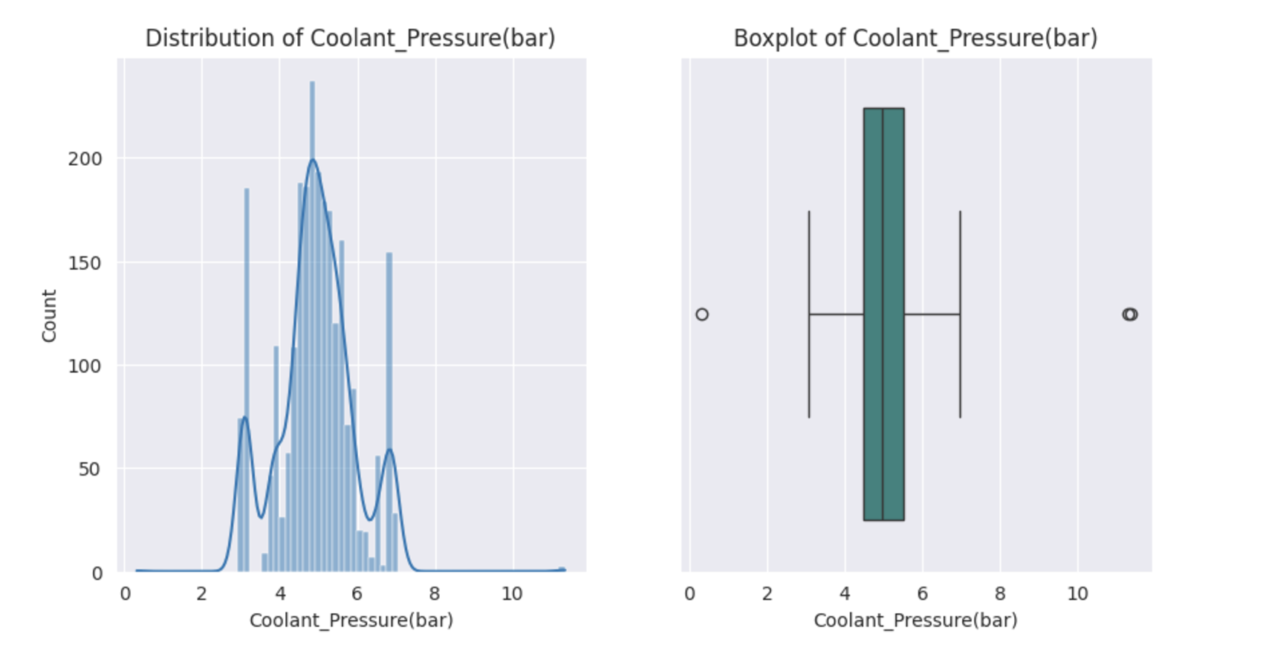
Exploratory Data Analysis [EDA]
Coolant Pressure
MOMENTS OF BUSINESS :
Mean : 4.95
Median : 4.94
Mode : 8 modes : 4.566854, 4.842521, 5.567857, 5.918357, 6.560332, 6.839413, 6.863944, 6.893182
Variance : 0.9947
Standard Deviation : 0.997
Range : 11.025
Skewness : 0.147
Kurtosis : 1.169
Notes:
EDA is used for seeing what the data can tell us before the modeling task.
Change

Slide 11
Exploratory Data Analysis [EDA]
Statistical Insights
Business Insights
Symmetric Distribution : Mean (4.95) ≈ Median (4.94); slight positive skew (0.147).
Outliers have minimal impact.
Operational Clusters : Eight modes suggest specific tasks or phases.
Consistency : Narrow spread; variance (0.995) and standard deviation (0.997) are low.
Wide Range : High range (11.025) indicates occasional extreme conditions.
Leptokurtic Distribution : Frequent values near the mean with fewer extremes (Kurtosis: 1.169).
Extreme Conditions : Investigate and address extreme operations (range: 11.025) to reduce maintenance costs and increase machinery lifespan.
Stable Operations : Low spread indicates a stable environment, simplifying monitoring and performance regulation.
Anomalies : Analyze extremes for potential machinery errors; correct to maximize efficiency.
High Pressure & Downtime : Investigate correlation between high-pressure conditions and downtime.
Notes:
EDA is used for seeing what the data can tell us before the modeling task.
Change

Slide 12
Exploratory Data Analysis [EDA]
Coolant Pressure
MOMENTS OF BUSINESS :
Mean : 4.95
Median : 4.94
Mode : 8 modes : 4.566854, 4.842521, 5.567857, 5.918357, 6.560332, 6.839413, 6.863944, 6.893182
Variance : 0.9947
Standard Deviation : 0.997
Range : 11.025
Skewness : 0.147
Kurtosis : 1.169
Notes:
EDA is used for seeing what the data can tell us before the modeling task.
Change

Slide 13
Exploratory Data Analysis [EDA]
Statistical Insights
Business Insights
Symmetry & Consistency:
Mean (4.95) ≈ Median (4.94): Symmetric distribution with consistent coolant pressure during operations.
Narrow Spread:
Variance (0.995) and standard deviation (0.997) show stable operating conditions.
Operational Clusters:
Eight modes suggest distinct tasks or operational phases.
High Range (11.025):
Indicates occasional extreme conditions; investigate causes and impacts on efficiency.
Leptokurtic Distribution:
Frequent values around the mean with fewer extremes; stable operation overall.
Extreme Operations:
Investigate high-pressure conditions (Range = 11.025).
Address if impact is significant to minimize maintenance costs and maximize equipment efficiency.
Stable Environment:
Low spread indicates stable operations, making performance monitoring easier.
Analyze Extremes:
Check if extremes are errors in machinery function; correct to improve efficiency.
Correlations:
Investigate if high-pressure operations are linked to downtime.
Notes:
EDA is used for seeing what the data can tell us before the modeling task.
Change

Slide 14
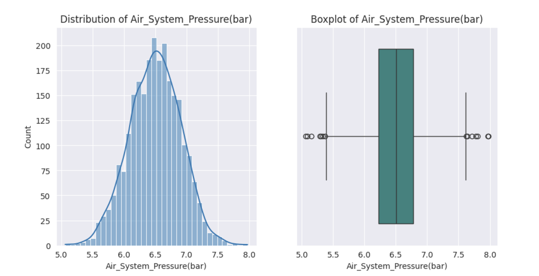
Exploratory Data Analysis [EDA]
Air System Pressure
MOMENTS OF BUSINESS :
Mean : 6.499
Median : 6.505
Mode : 11 modes : 5.628717, 5.928643, 5.955235, 6.011483, 6.167549, 6.430073, 6.668245, 6.753560, 6.836188, 6.875058, 6.940606
Variance : 0.166
Standard Deviation : 0.4073
Range : 2.911
Skewness : -0.0529
Kurtosis : -0.001578
Notes:
EDA is used for seeing what the data can tell us before the modeling task.
Change

Slide 15
Exploratory Data Analysis [EDA]
Statistical Insights
Business Insights
Symmetric Distribution:
Mean (6.499) and Median (6.505) are nearly equal, indicating a symmetric distribution.
Outliers:
Outliers are present, but the small range suggests stable pressure.
Operating Conditions:
11 modes indicate the machine operates under multiple conditions.
Low Variability:
Low variance (0.166) and standard deviation (0.4073) show values cluster around the mean.
Minimal Skewness & Kurtosis:
Skewness (-0.0529) and kurtosis (-0.001578) are close to 0, indicating a nearly normal distribution.
Stable Operations:
Low standard deviation & small range indicate consistent air system pressure, ensuring stable performance.
Multiple Modes:
11 modes suggest different operational phases. Further analysis can optimize equipment efficiency.
Narrow Curve:
System operates under strict conditions, ensuring precision and safety with minimal extreme conditions.
Outlier Investigation:
Regularly check outliers to prevent anomalies and mitigate risks.
Regular Monitoring & Maintenance:
Monitor for consistent operations and address any fluctuations to reduce wear and tear, minimizing maintenance costs.
Notes:
EDA is used for seeing what the data can tell us before the modeling task.
Change

Slide 16
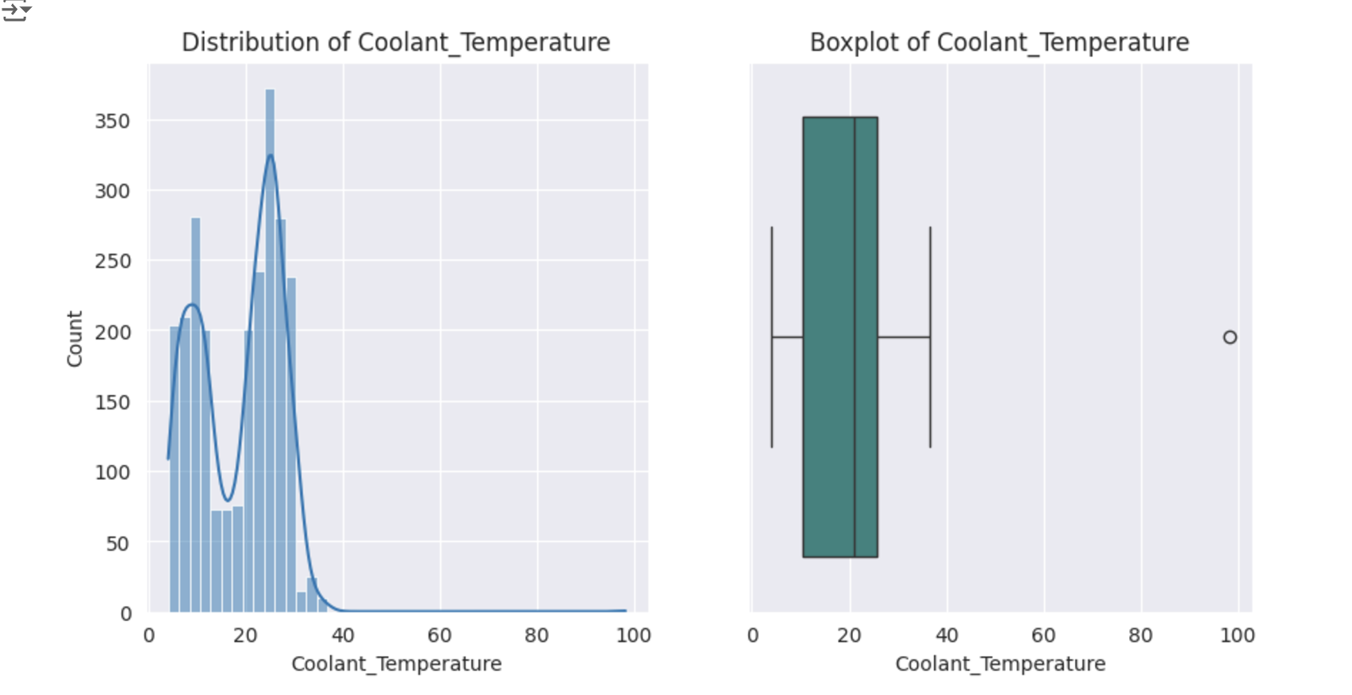
Exploratory Data Analysis [EDA]
Coolant Temperature
MOMENTS OF BUSINESS :
Mean : 18.559
Median : 21.2
Mode : 1 mode : 26.4
Variance : 0.732
Standard Deviation : 8.554
Range : 94.1
Skewness : 0.108
Kurtosis : 1.565
Notes:
EDA is used for seeing what the data can tell us before the modeling task.
Change

Slide 17
Exploratory Data Analysis [EDA]
Statistical Insights
Business Insights
Skewed Distribution:
Mean (18.559) < Median (21.2), slight positive skew (0.108).
Mode at 26.4:
Represents normal operational temperature.
Large Range (94.1):
Indicates possible outliers and high workload causing elevated temperatures.
Leptokurtic Distribution:
Kurtosis (1.565) suggests more extreme values than normal distribution.
Optimal Temperature:
Mode at 26.4°C suggests most operations occur here. Optimize factors to enhance efficiency at this temperature.
Ensure this temperature is ideal for system performance.
Fluctuations:
Large range (94.1°C) and 75% of values under 25.2°C suggest temperature variability.
Monitor fluctuations to prevent negative impact on lifespan and performance.
High Temperatures:
Investigate occasional high temperatures (max 98.2°C) for potential overheating issues.
Review operations to ensure they don’t compromise equipment longevity.
Regular Monitoring:
Regularly track coolant temperature to maintain stability, reduce maintenance costs, and optimize performance.
Notes:
EDA is used for seeing what the data can tell us before the modeling task.
Change

Slide 18
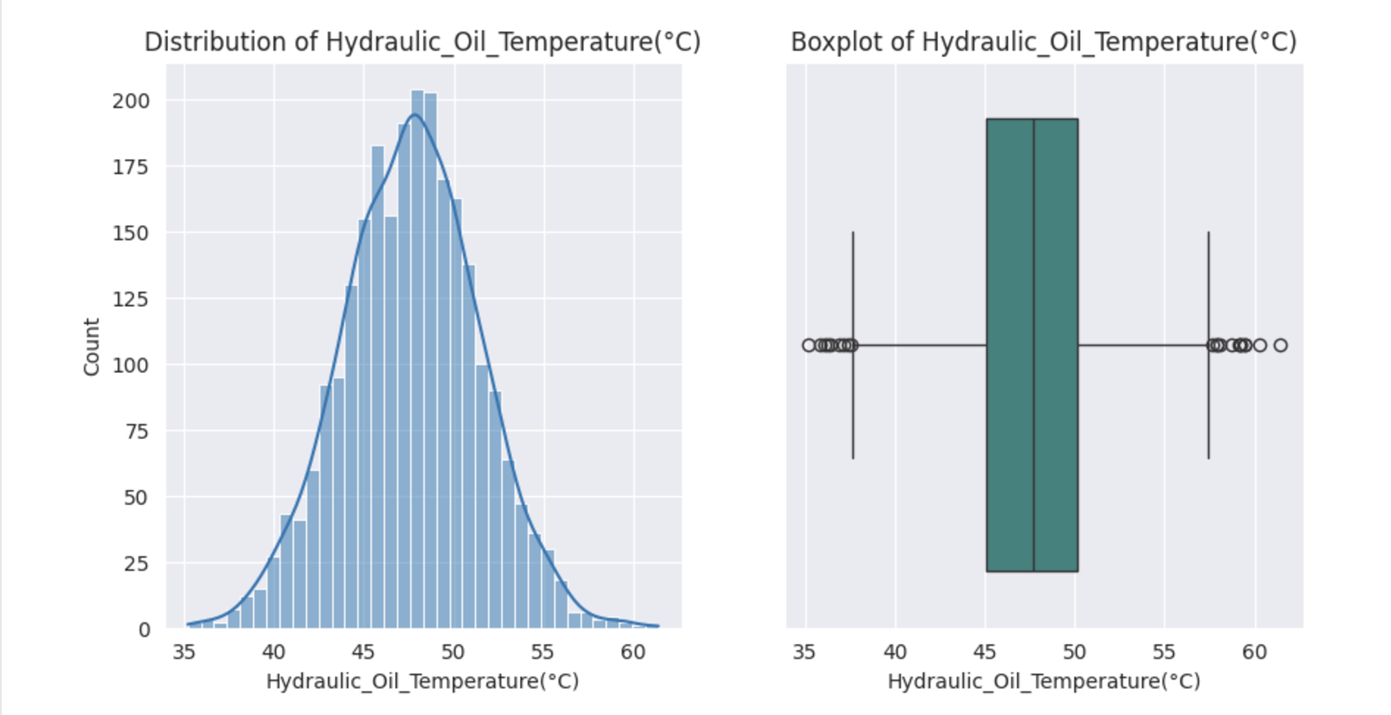
Exploratory Data Analysis [EDA]
Hydraulic Oil Temperature
MOMENTS OF BUSINESS :
Mean : 47.618
Median : 47.7
Mode : 3 modes : 47.5, 48.0, 50.0
Variance : 14.203
Standard Deviation : 3.769
Range : 26.199
Skewness : -0.0023
Kurtosis : 0.038
Notes:
EDA is used for seeing what the data can tell us before the modeling task.
Change

Slide 19
Exploratory Data Analysis [EDA]
Statistical Insights
Business Insights
Symmetric Distribution:
Mean (47.6) close to median (47.7), with skewness near zero (-0.0023).
Operational Phases:
Three modes (47.5, 48.0, 50.0) likely represent different phases.
Stable Operations:
Low standard deviation (3.77) and variance (14.20) indicate stable conditions.
No Anomalies:
Small range (26.2) suggests no major issues.
Mesokurtic Distribution:
Kurtosis near zero (0.038), indicating typical distribution without extreme values.
Stable Operations:
Skewness near zero indicates stable temperature, supporting component lifespan.
Small range and low variability rule out overheating issues, reducing maintenance costs.
Modes Indicate Phases:
Three modes at 47.5, 48.0, 50.0 reflect temperature during different operational phases.
Maintenance & Monitoring:
Ensure proper maintenance of heating/cooling systems to maintain efficiency.
Implement a monitoring system to avoid temperature fluctuations that can affect the entire unit.
Notes:
EDA is used for seeing what the data can tell us before the modeling task.
Change

Slide 20
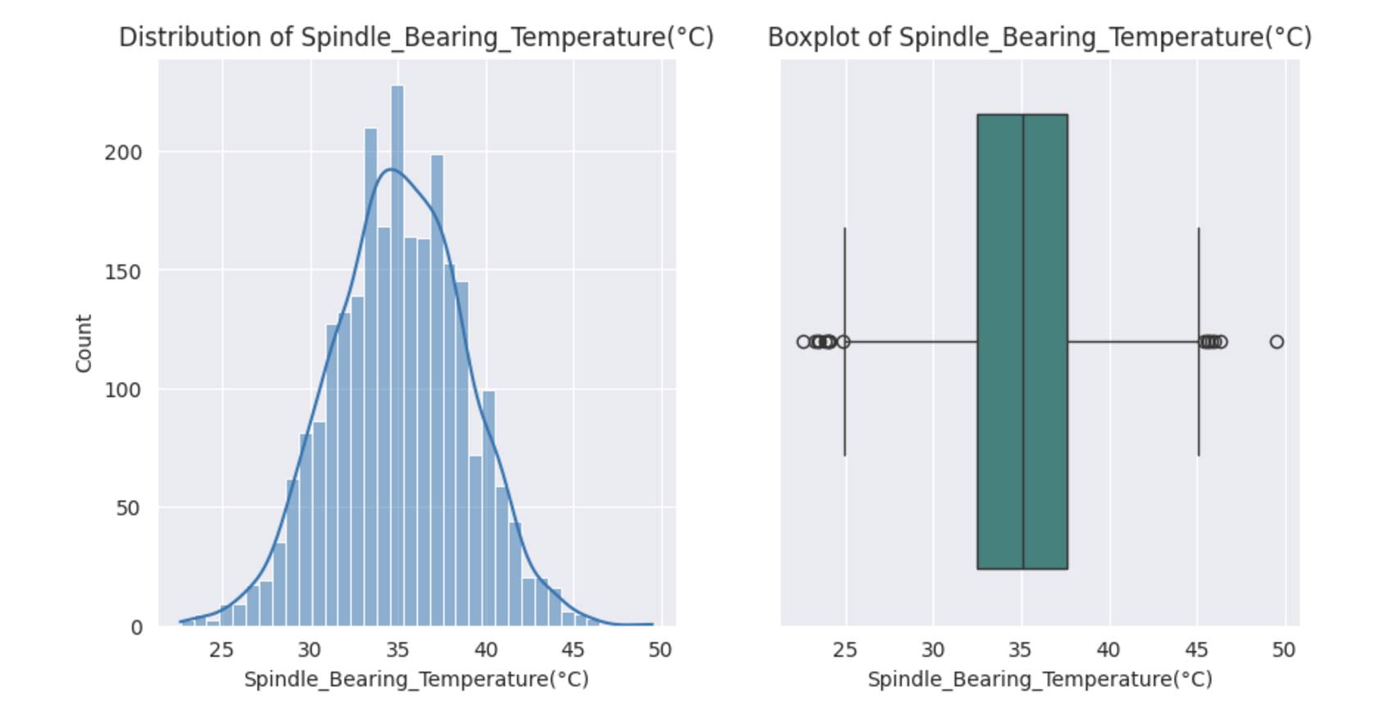
Exploratory Data Analysis [EDA]
Spindle Bearing Temperature
MOMENTS OF BUSINESS :
Mean : 35.064
Median : 35.1
Mode : 1 mode : 34.6
Variance : 14.174
Standard Deviation : 3.765
Range : 26.9
Skewness : -0.0359
Kurtosis : -0.0439
Notes:
EDA is used for seeing what the data can tell us before the modeling task.
Change

Slide 21
Exploratory Data Analysis [EDA]
Statistical Insights
Business Insights
Symmetrical Distribution:
Mean (35.064) and median (35.1) are close, indicating a balanced distribution.
Mode (34.6) is also near the mean.
Low Variability:
Standard deviation (3.765) and variance (14.174) suggest consistent temperature.
Moderate Range:
Range (26.9) indicates temperature variations are within permissible limits.
No Significant Skewness/Kurtosis:
Skewness (-0.0359) and kurtosis (-0.0439) are close to zero, indicating no extreme temperature fluctuations or outliers.
Well-Regulated Temperature:
Symmetrical distribution and narrow spread suggest consistent operation, minimizing overheating and maintenance costs.
Optimized Settings:
Central tendency clustering around 35°C indicates stable operation, potentially extending spindle life and maximizing equipment efficiency.
Outliers:
Investigate rare outliers for potential links to spindle breakdowns and downtime.
Monitoring System:
Recommend continuous temperature monitoring to prevent unexpected fluctuations and optimize spindle performance.
Predictive Model:
Build a model for proactive monitoring and optimization, reducing costs and enhancing efficiency.
Notes:
EDA is used for seeing what the data can tell us before the modeling task.
Change

Slide 22
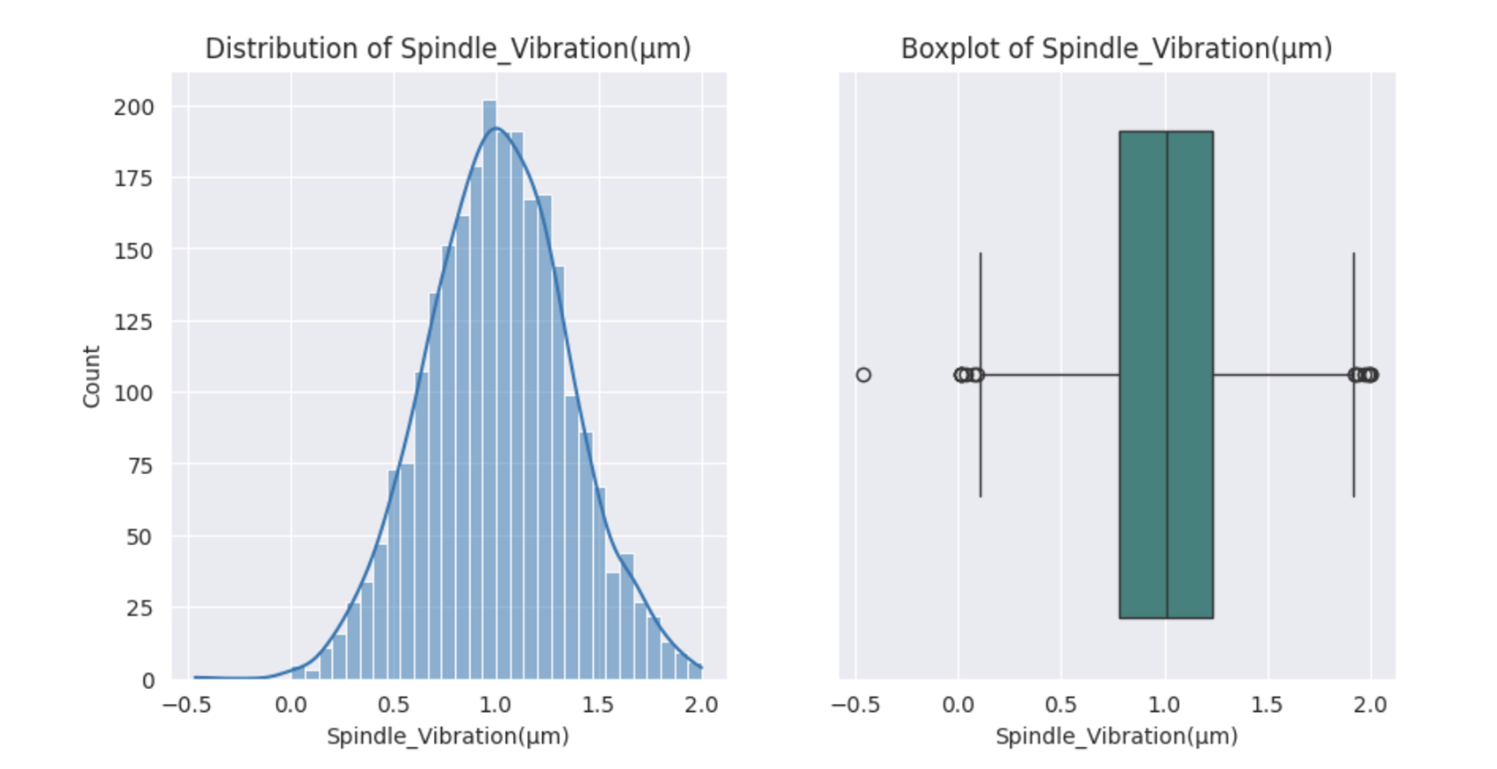
Exploratory Data Analysis [EDA]
Spindle Vibration
MOMENTS OF BUSINESS :
Mean : 1.009
Median : 1.008
Mode : 1 mode : 1.231
Variance : 0.118
Standard Deviation : 0.343
Range : 2.461
Skewness : 0.0015
Kurtosis : -0.0187
Notes:
EDA is used for seeing what the data can tell us before the modeling task.
Change

Slide 23
Exploratory Data Analysis [EDA]
Statistical Insights
Business Insights
Symmetrical Distribution:
Mean (1.009) and median (1.008) are nearly identical, indicating symmetry.
Skewness (0.0015) is almost zero.
Clustered Values:
Mode (1.231) is greater than the mean and median, indicating a cluster around this point.
Consistent Values:
Low variance (0.118) and standard deviation (0.343) suggest stable spindle vibration.
Measurement Error:
Minimum value (-0.46) appears to be an error, contributing to a large range (2.461).
Outlier Investigation:
The outlier (-0.46) needs to be checked for measurement errors.
Evaluate system performance for this record.
Vibration Control:
Low to moderate variance indicates controlled spindle vibration.
Further optimization can enhance efficiency and reduce downtime.
Monitoring & Regulation:
Implement a system to monitor and control spikes/dips in vibration.
This will extend spindle lifespan and improve performance.
Stable Operations:
Symmetric distribution suggests minimal anomalies.
Regular checks can reduce maintenance costs and improve efficiency.
Notes:
EDA is used for seeing what the data can tell us before the modeling task.
Change

Slide 24
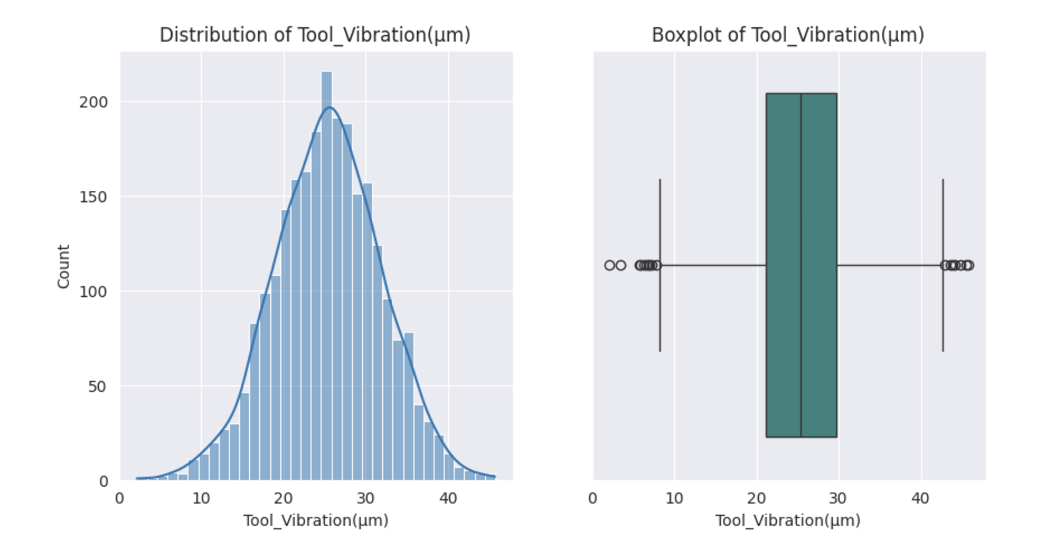
Exploratory Data Analysis [EDA]
Tool Vibration
MOMENTS OF BUSINESS :
Mean : 25.412
Median : 25.455
Mode : 2 modes : 26.736, 30.585
Variance : 41.437
Standard Deviation : 6.437
Range : 43.565
Skewness : -0.061
Kurtosis : 0.0065
Notes:
EDA is used for seeing what the data can tell us before the modeling task.
Change

Slide 25
Exploratory Data Analysis [EDA]
Statistical Insights
Business Insights
Symmetrical Distribution:
Mean (25.412) and median (25.455) are nearly equal, indicating balanced vibration levels.
Frequent Vibrations:
Modes (26.736, 30.585) show common vibration points.
Range & Fluctuations:
Minimum: 2.2, Maximum: 45.7, indicating significant fluctuations.
Moderate Variability:
Standard deviation (6.437) and variance (41.437) suggest moderate spread in vibration values.
Wide Range & Minimum Value:
Investigate to reduce wear and tear, minimizing maintenance costs.
Outliers in Vibration:
Evaluate records with high outliers for further assessment.
High Vibration Fluctuations:
Address to prevent poor performance and reduce machine longevity.
Mode Values:
Check frequent vibration points for validity.
Optimal Vibration Levels:
Set optimal values to avoid fluctuations, improve tool life, and maximize efficiency.
Notes:
EDA is used for seeing what the data can tell us before the modeling task.
Change

Slide 26
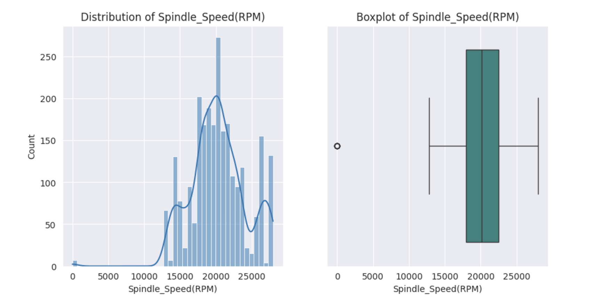
Exploratory Data Analysis [EDA]
Spindle Speed
MOMENTS OF BUSINESS :
Mean : 20274.792
Median : 20137.5
Mode : 1 mode : 17726
Variance : 14842990
Standard Deviation : 3852.66
Range : 27957
Skewness : -0.1725
Kurtosis : 1.3448
Notes:
EDA is used for seeing what the data can tell us before the modeling task.
Change

Slide 27
Exploratory Data Analysis [EDA]
Statistical Insights
Business Insights
Symmetrical Distribution:
Mean (20,274.79) and median (20,137.5) are close, indicating near-symmetry.
Consistent Mode:
Mode value (17,726) shows most operations occur at this spindle speed.
Fluctuations in Speed:
Moderate standard deviation (3,852.66) and variance (14,842,990) indicate fluctuations.
Outlier Detection:
Minimum value of '0' is an outlier, requires further investigation.
Wide Operational Range:
Range (27,957) suggests varying phases of operation.
Slight Left Skew:
Skewness (-0.1725) indicates a slight leftward distribution.
Zero Speed:
Investigate why spindle speed is zero during certain phases.
Could indicate specific operating conditions.
Wide Speed Range:
Determine if it reflects different operating conditions or faulty machinery.
Most Operations Between 17,500 - 28,000 RPM:
Standardize speed for each operation to optimize output and equipment efficiency.
High Variability:
Implement strong monitoring to analyze optimal conditions.
Aim to minimize maintenance cost and maximize equipment efficiency.
Notes:
EDA is used for seeing what the data can tell us before the modeling task.
Change

Slide 28
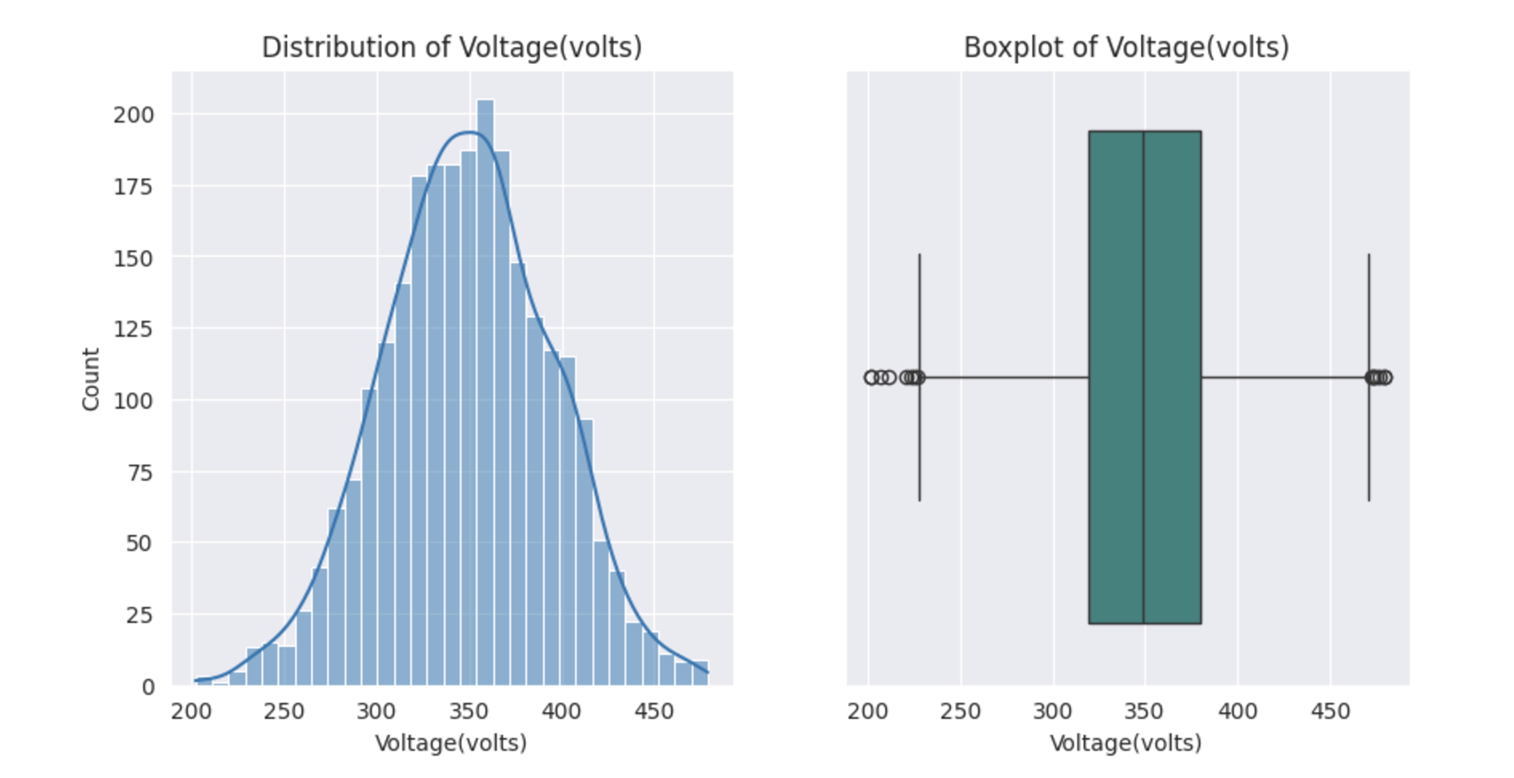
Exploratory Data Analysis [EDA]
Voltage
MOMENTS OF BUSINESS :
Mean : 348.997
Median : 349
Mode : 1 mode : 337
Variance : 2058.984
Standard Deviation : 45.376
Range : 277
Skewness : -0.0287
Kurtosis : -0.0903
Notes:
EDA is used for seeing what the data can tell us before the modeling task.
Change

Slide 29
Exploratory Data Analysis [EDA]
Statistical Insights
Business Insights
Symmetrical Distribution:
Mean (348.997) and median (349) are nearly equal, indicating a symmetrical distribution.
Slight Left Skew:
Small negative skewness (-0.0287) and mode (337) suggest a slight left skew.
Low Fluctuations:
Standard deviation (45.376) and variance (2,058.984) are low, indicating stable voltage.
Wide Range (277):
The wide range may reflect different operational phases.
Wide Voltage Range:
Fluctuations can be hazardous; monitoring is crucial to prevent machinery damage and downtime.
Outliers:
Not extreme; frequent checks can minimize potential damage and reduce maintenance costs.
Voltage Distribution:
75% of values are under 380V; precautions needed for the 25% (380-479V) to prevent burnouts.
Low Voltage:
If caused by power supply issues, implement stabilizing techniques to ensure maximum efficiency and component lifespan.
Notes:
EDA is used for seeing what the data can tell us before the modeling task.
Change

Slide 30
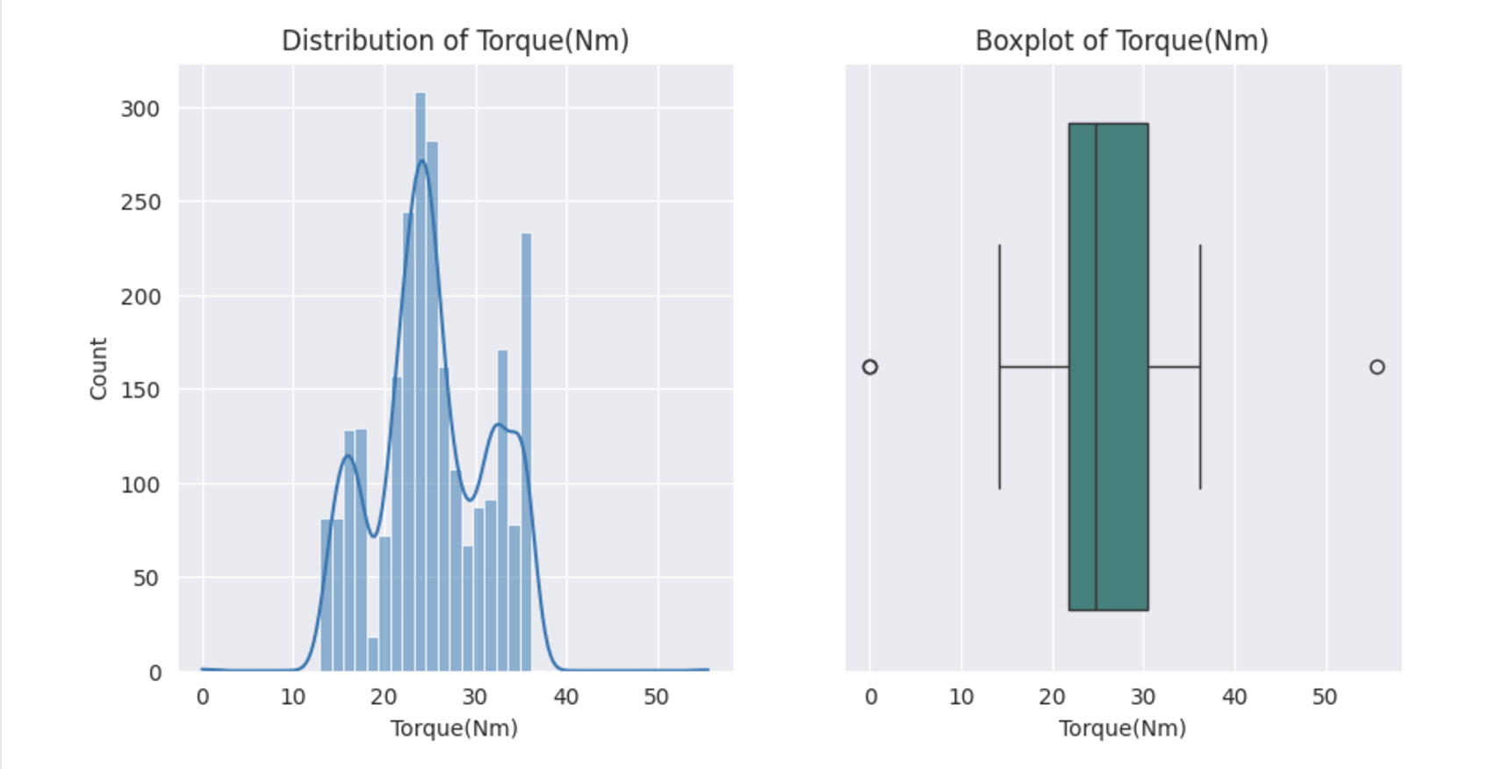
Exploratory Data Analysis [EDA]
Torque
MOMENTS OF BUSINESS :
Mean : 25.235
Median : 24.648
Mode : 1 mode : 35.580334
Variance : 37.682
Standard Deviation : 6.139
Range : 55.5524
Skewness : 0.0306
Kurtosis : -0.4656
Notes:
EDA is used for seeing what the data can tell us before the modeling task.
Change

Slide 31
Exploratory Data Analysis [EDA]
Statistical Insights
Business Insights
Right-Skewed Distribution:
Mode (35.58) higher than mean (25.24) suggests torque is often higher for certain tasks.
Variability:
Moderate standard deviation (6.14) and variance (37.68) indicate fluctuating twisting forces.
Minimum Value of 0:
Indicates no torque needed for some operations.
Wide Range (55.55):
Significant variation in torque needed for different operations.
Outliers:
Minimum and maximum values may indicate errors or special operational phases.
Wide Range & High Standard Deviation:
Torque varies significantly (0 to 55.55 N) based on operational needs.
High Torque Operations:
Most operations require high tool rotation, indicating frequent high-torque conditions.
Torque Clusters:
Common torque levels may reflect different operational phases.
Maintenance Recommendations:
Regular wear and tear checks to minimize maintenance costs and maximize equipment efficiency.
Notes:
EDA is used for seeing what the data can tell us before the modeling task.
Change

Slide 32
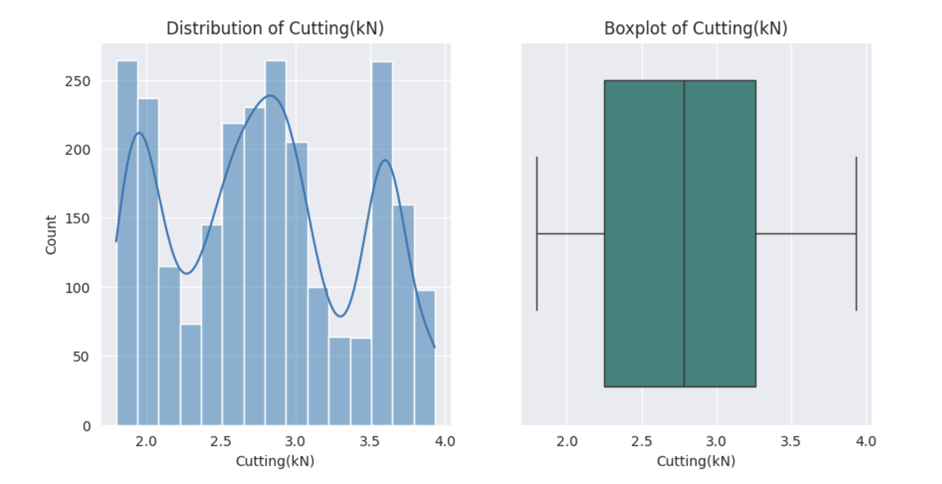
Exploratory Data Analysis [EDA]
Cutting
MOMENTS OF BUSINESS :
Mean : 2.783
Median : 2.78
Mode : 2 modes : 3.55, 3.67
Variance : 0.3803
Standard Deviation : 0.617
Range : 2.13
Skewness : 0.1139
Kurtosis : -1.0872
Notes:
EDA is used for seeing what the data can tell us before the modeling task.
Change

Slide 33
Exploratory Data Analysis [EDA]
Statistical Insights
Business Insights
Consistent Cutting Forces:
Mean (2.783) and median (2.78) are nearly the same, indicating consistency.
Small standard deviation (0.617) and variance (0.3803).
Frequent Cutting Forces:
Modes (3.55, 3.67) represent the most common cutting forces.
Wide Range (2.13):
Indicates varying cutting forces for different operations.
Slight Positive Skew (0.1139):
Distribution is slightly skewed towards higher values.
Two Modes:
Likely due to different materials used in operations.
No Outliers:
Indicates proper machine calibration for operational forces.
Regular Monitoring:
Ensures low variance, minimizing maintenance costs, and improving efficiency.
Optimal Functioning:
Smaller skewness and moderate standard deviation point to efficient tool performance, reducing downtime.
Notes:
EDA is used for seeing what the data can tell us before the modeling task.
Change

Slide 34
Data Preprocessing
143 Null Values were there.
Since all the columns are close to symmetry, mean imputation is done.
No duplicated values are present in the dataset.
Notes:
Keep observations

Slide 35
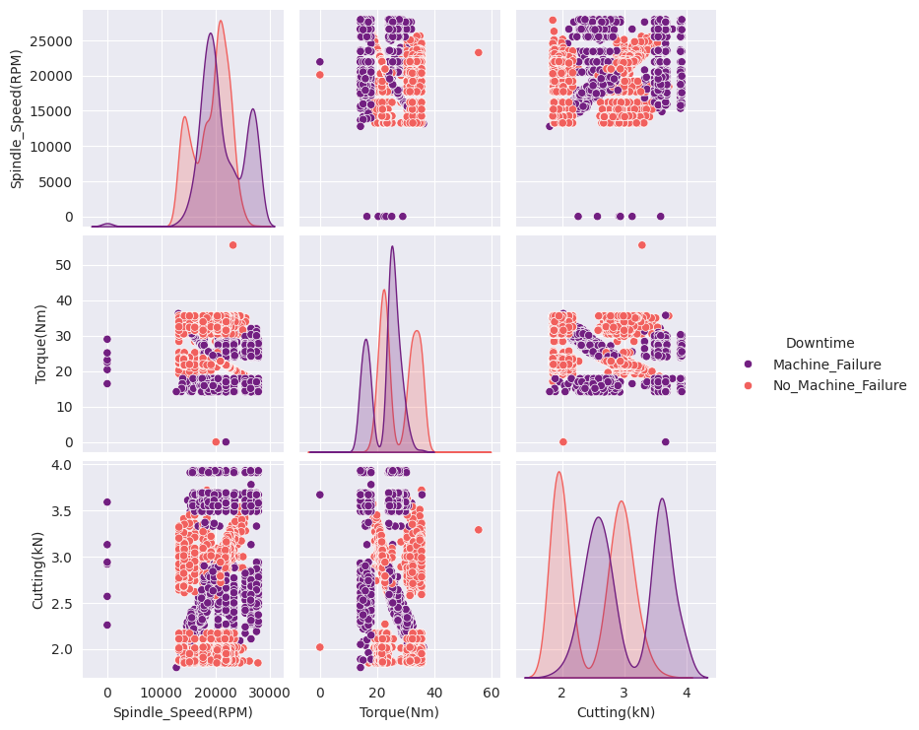
Data Visualization
Cutting Forces, Torque and Spindle speed Vs Downtime
Notes:
Add graphical

Slide 36
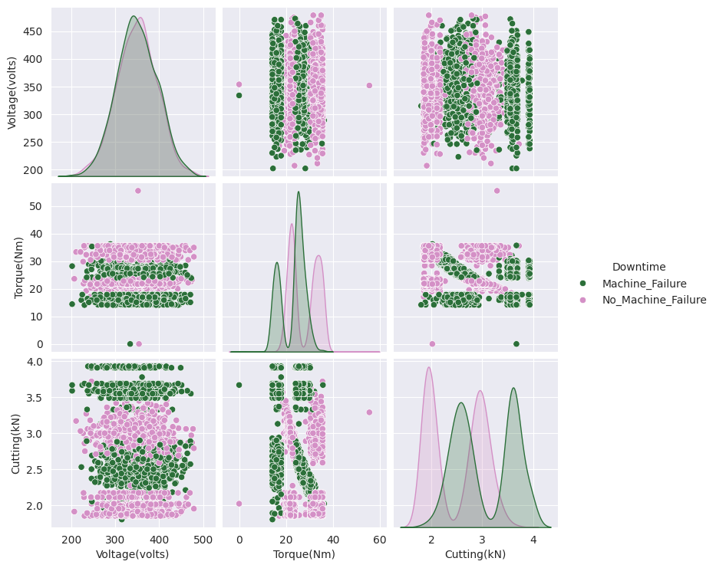
Data Visualization
Voltage and Forces Vs Downtime
Notes:
Add graphical

Slide 37
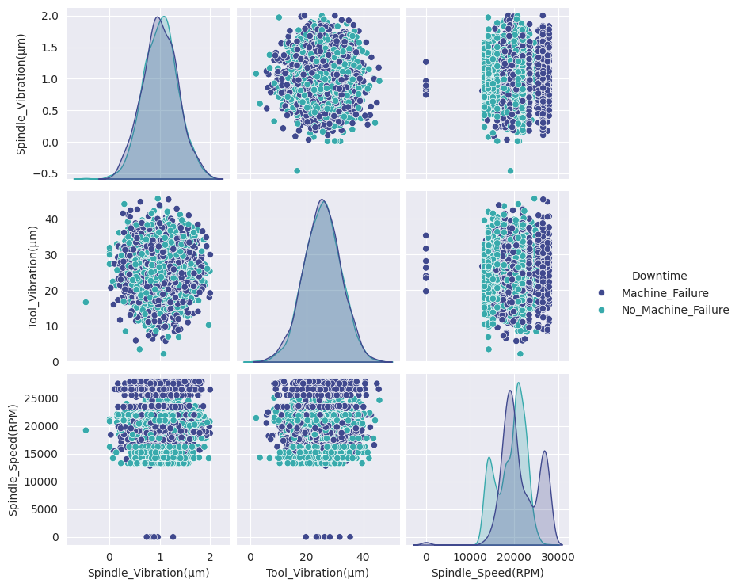
Data Visualization
3. Vibrations and Speed Vs Downtime :
Notes:
Add graphical

Slide 38
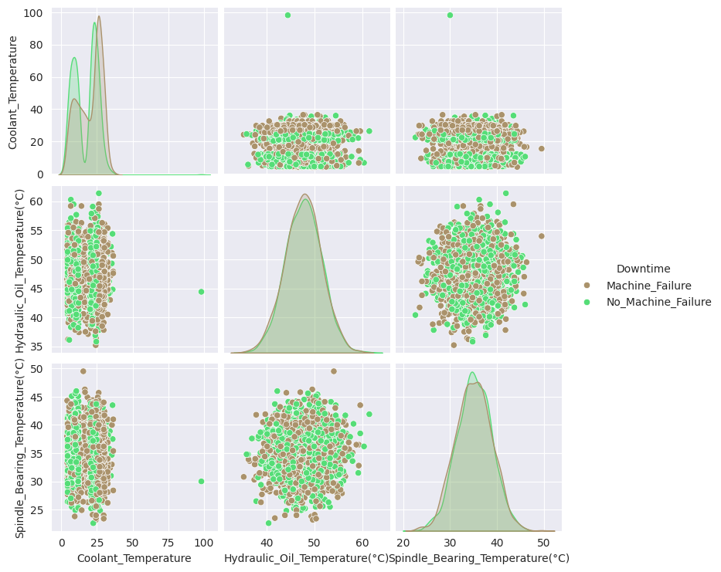
Data Visualization
Temperature and Vs Downtime
Notes:
Add graphical

Slide 39
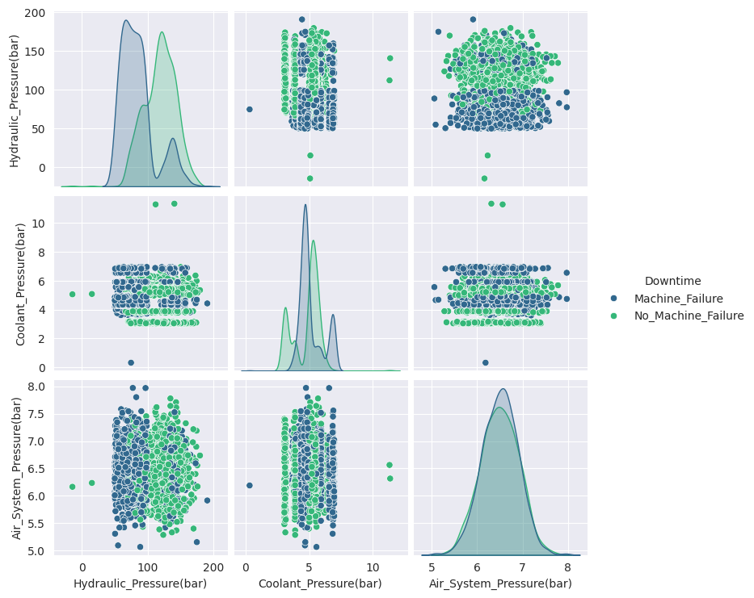
Data Visualization
Pressure Vs Downtime
Notes:
Add graphical

Slide 40
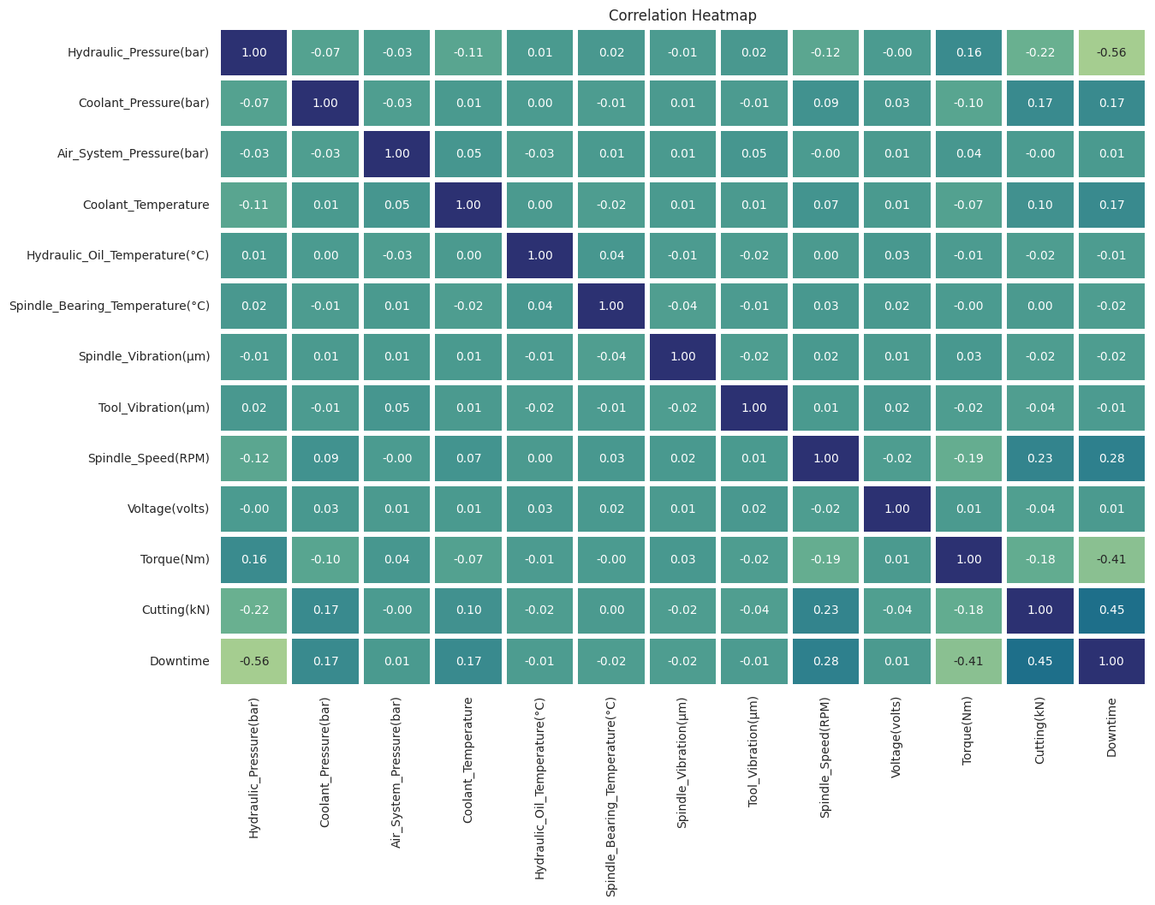
Data Visualization
CORRELATION MATRIX
Notes:
Add graphical

Slide 41


